Slide 1
EE 214 Digital Systems Lab 04/08/2023 Course Overview
Siddharth tallur
Associate professor, iit Bombay
http://www.ee.iitb.ac.in/~stallur/index.php
stallur@ee.iitb.ac.in

Slide 2
Course overview
Complementary course to EE 224
Learning objectives:
Design, description, simulation and synthesis of digital subsystems in VHDL
Validation of designs using testbenches and scan chain environment
Implementation on Xen-10 (MAX-10 FPGA-based) board

Slide 3
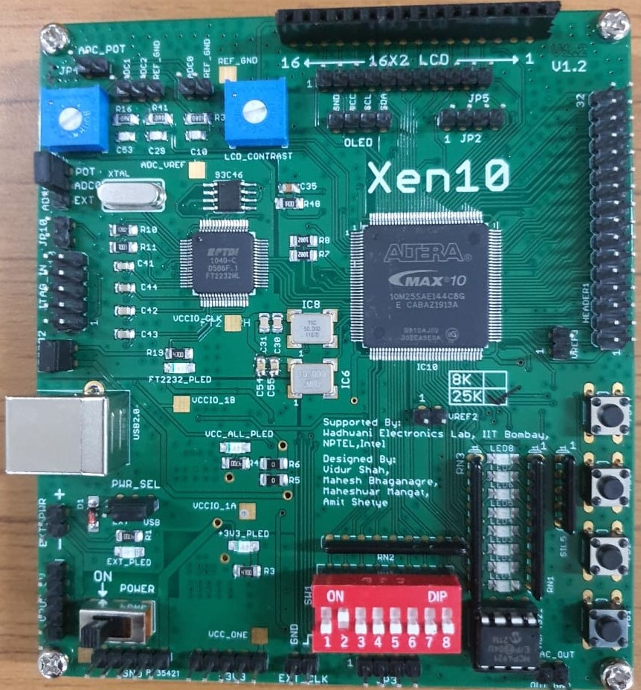
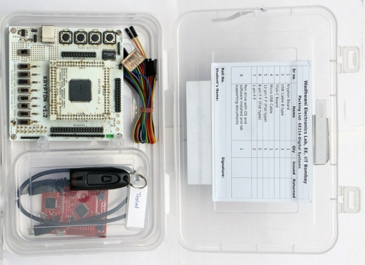
Lab kit
WEL staff and RAs have worked hard over the years to develop the Xen-10 board.
Each board has been hand-soldered and tested in WEL. Please be respectful of efforts put in by several folks to bring this board to you and use the boards carefully.
During COVID-19, WEL staff worked hard to assemble and courier such lab kits to students to their homes to allow lab courses to continue despite several challenges.

Slide 4
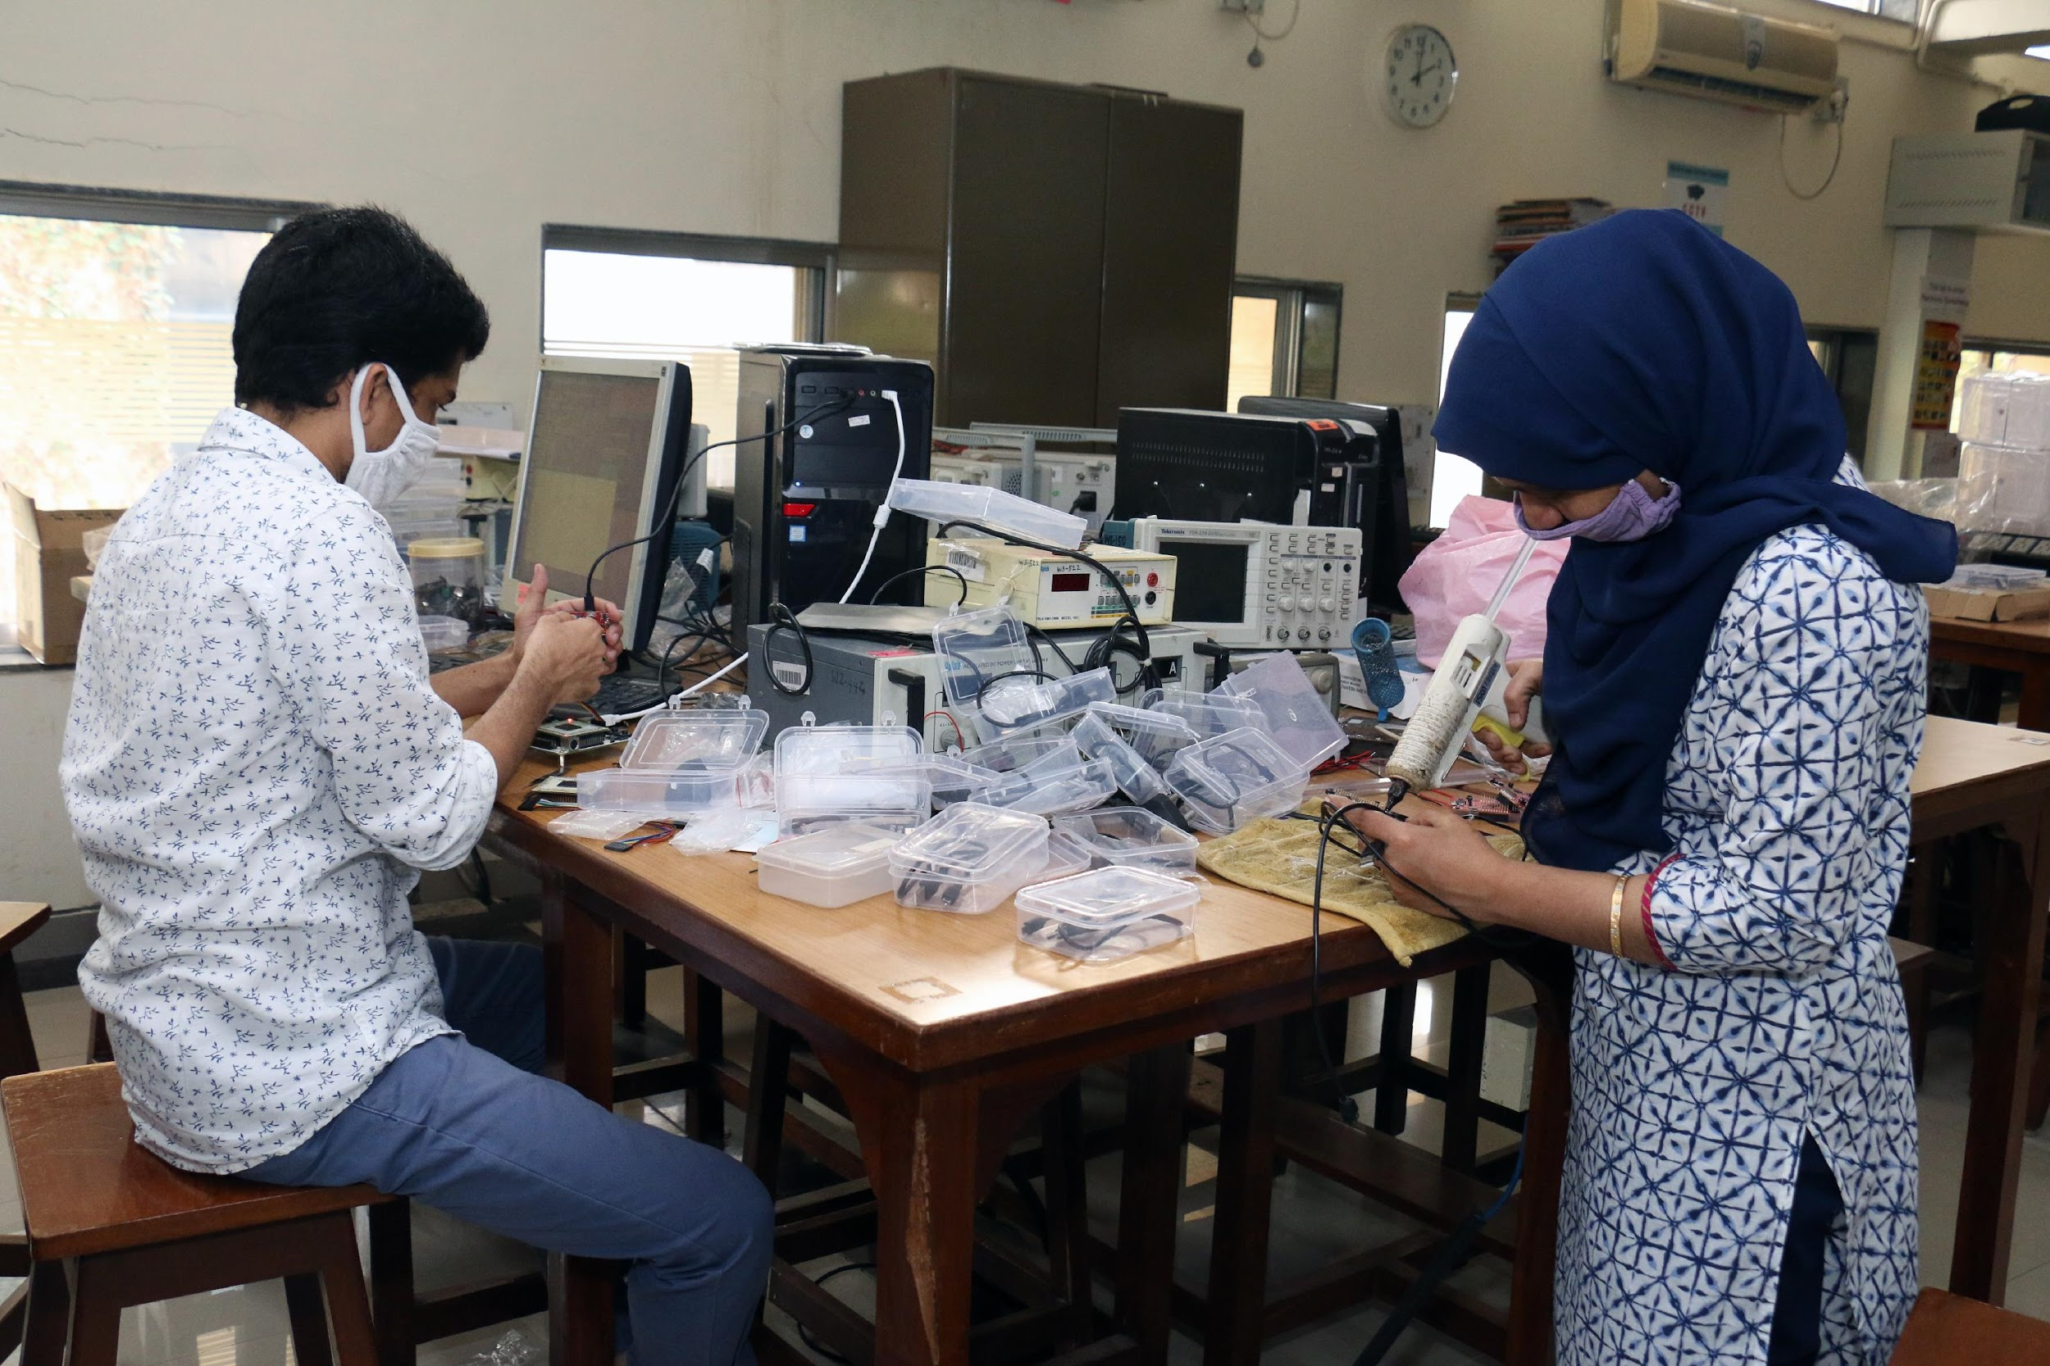
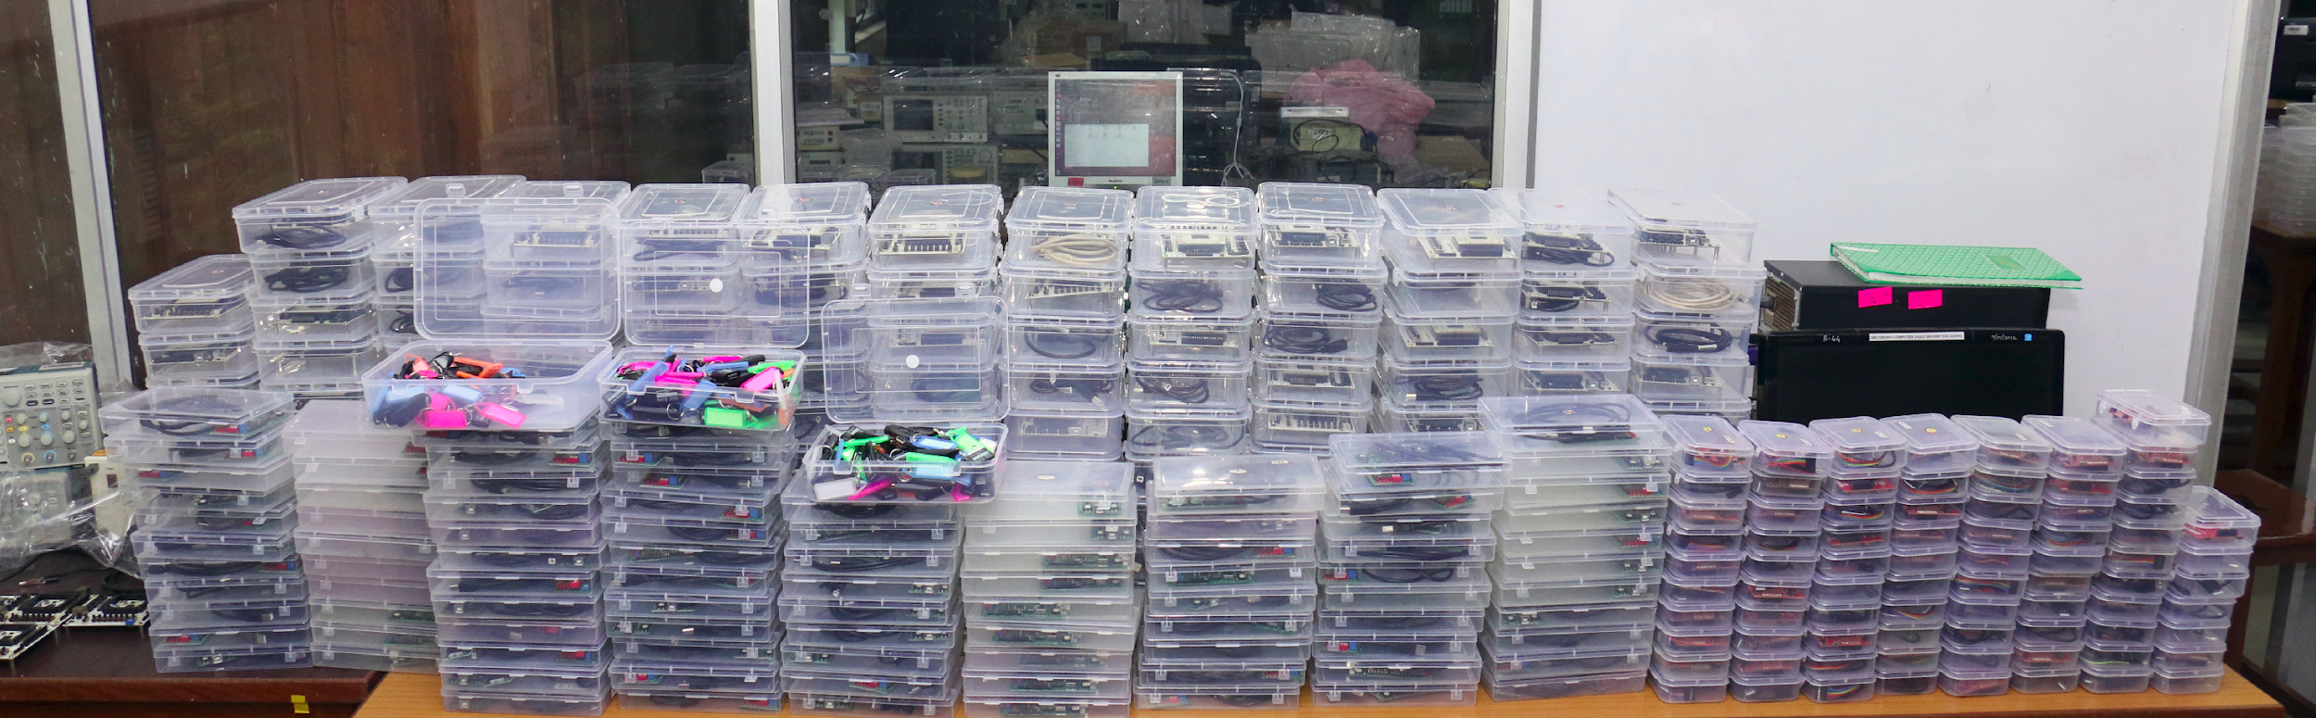
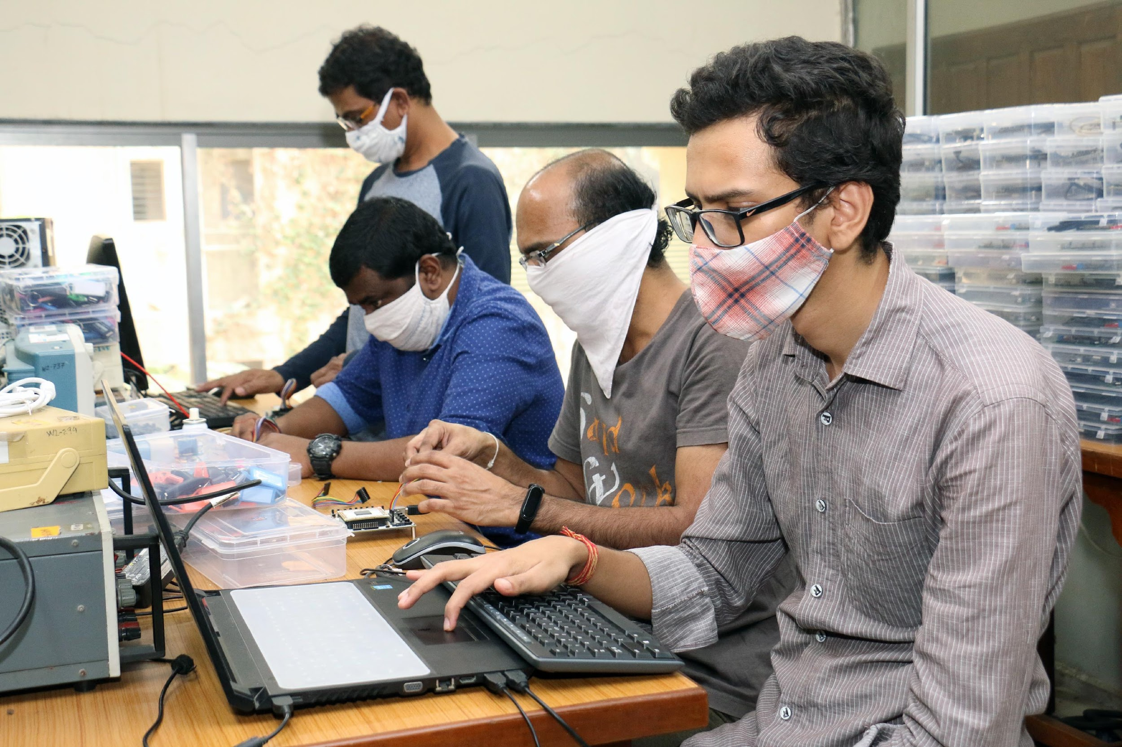
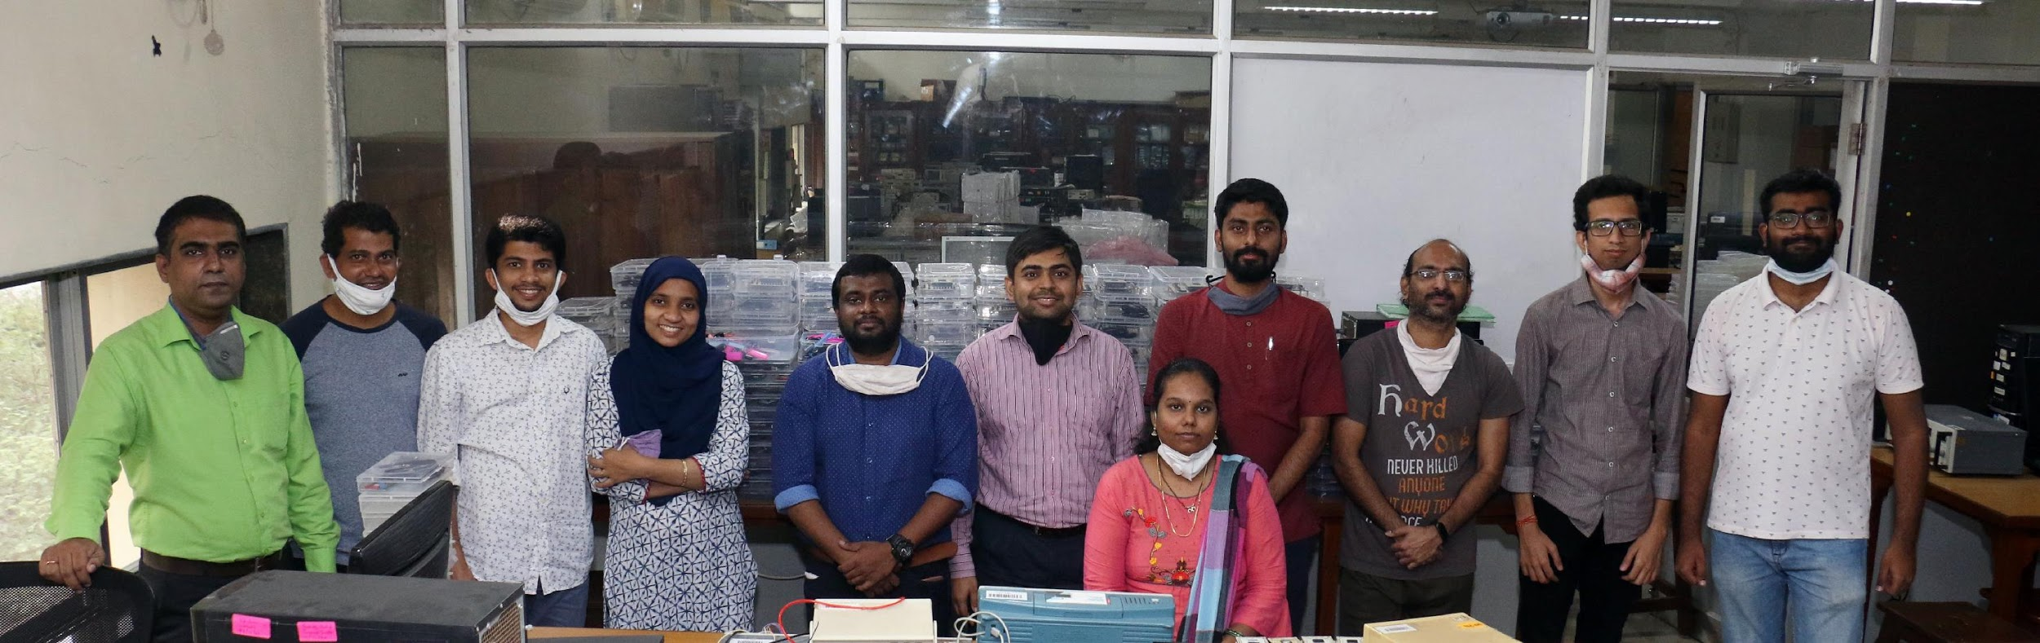
Lab kit

Slide 5
Logistics
Course will be operated using Moodle for resource sharing and announcements. The lab material will be posted on moodle and will also be available at https://ee214.github.io/
Since this course may overtake EE 224, pre-recorded lecture videos (by Prof. D. K. Sharma) will be uploaded for covering the background theory for all topics.
Experiments to be performed individually on Xen-10 board
Course will run in 2 slots:
Wednesday 2-5pm (B.Tech.)
Friday 2-5pm (DD)

Slide 6
Logistics
Most lab sessions will require you to complete pre-lab work assignment – please manage your time well!
We shall also conduct periodic quizzes to test your understanding during the semester – please stay up-to-date on course content
The lab sessions are designed such that you will be able to complete the work in the given lab slot itself (provided you are well prepared)
Topics for the upcoming lab session for the quiz and experiments will be declared one week in advance
Zero tolerance for plagiarism. Please do not copy the solutions/ reports. Severe penalties will be imposed, as permitted by institute rules.

Slide 7
Submitting your work
You must demonstrate your work to the TA/RA before you leave the lab and submit your report on Moodle
The simulation and scan chain verification demo should be presented to the TA during the lab session
The zipped VHDL project should be uploaded before you leave the lab (save a local backup as well)
You should upload reports on Moodle by the deadline. Deadlines are not negotiable.

Slide 8
Project
This year, we are introducing a course project for enhanced learning opportunities to apply concepts you have learnt, and appreciate the utility of digital systems for various applications
12 weeks are available for lab exercises and project, which are divided as follows:
Combinational logic: 6 weeks
Sequential logic: 3 weeks
Project: 3 weeks
Project guidelines will be shared soon

Slide 9
Attendance
Attendance is mandatory. ‘DX’ grade for insufficient attendance.
If you are unable to attend a lab session due to a medical emergency or illness, inform the instructor and your TA by email. If your absence is approved, you may complete your lab work before the next lab slot and upload report, code and results as directed.

Slide 10
Grading
Component | Weightage
Lab performance | 20
Reports | 5
Quizzes | 10
Project | 20
Midsem (30th September) | 20
Endsem (9th or 10th November) | 25
Lab performance: pen-paper design in notebook, VHDL code, RTL simulation, hardware validation
You must maintain a dedicated, hard-copy lab notebook. The notebook must be signed and dated by you and your TA before you leave the lab i.e., work must be certified before leaving the lab every week.
Even a single violation in maintenance of notebook will result in you forfeiting all marks for lab performance and reports (i.e. you lose 25% weightage towards your final grade)

